Slide 1
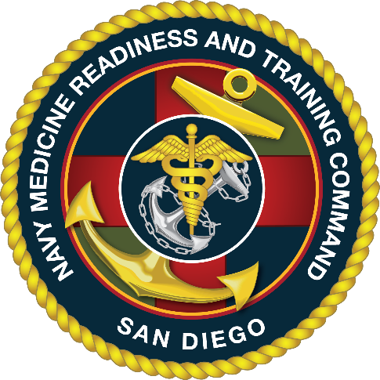
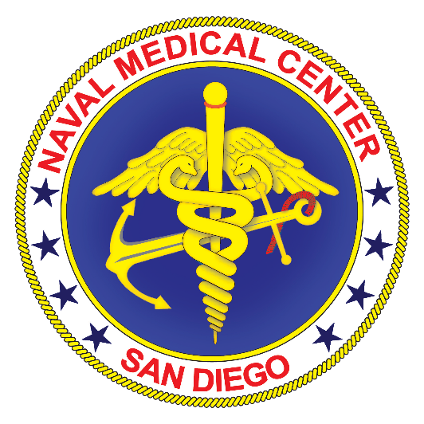
NTC Point Loma PHA Process
Point of Contact:
HM1(FMF) Arnold, Thomas
Medical Readiness Clinic
NMRTU Point Loma
“Anchored in Excellence, Committed to Health!”

Slide 2
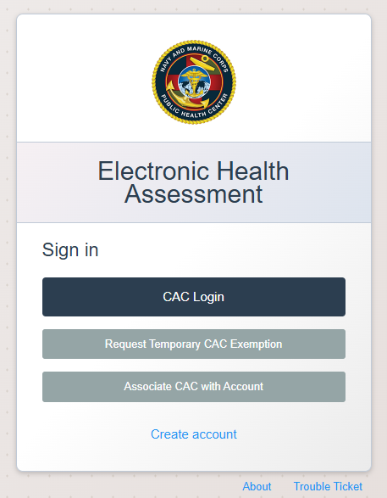
Step 1
Complete Part 1 of the ePHA at the following website:
https://eha.health.mil/eha/
“Anchored in Excellence, Committed to Health!”

Slide 3
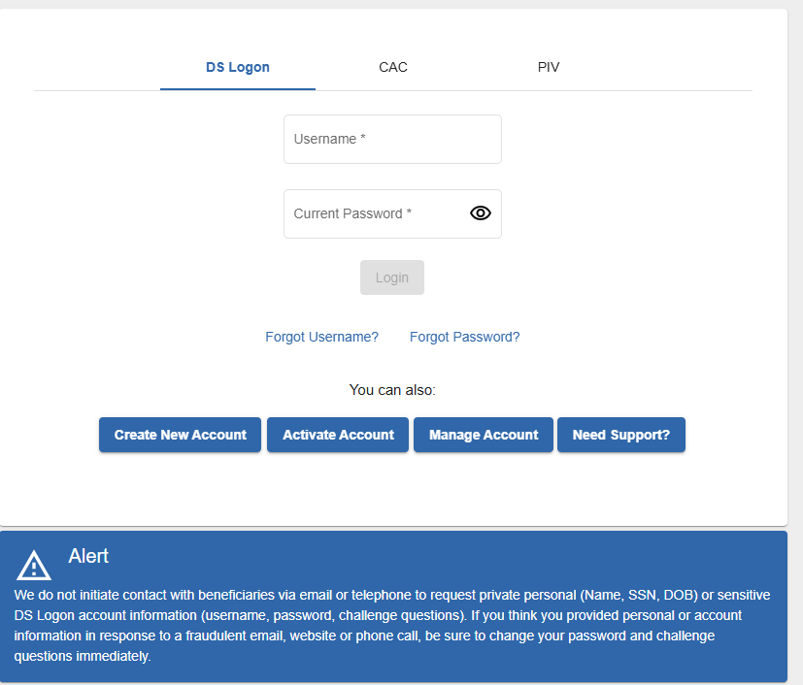
Step 2
Log into MHS Genesis Patient Portal at the following website:
https://myaccess.dmdc.osd.mil/identitymanagement/app/login
Reserve obligations
Reserve obligations
Source: Enrollment as of 26AUG24

Slide 4
Step 3
Verify Contact Information is correct and then press “Continue”.
Source: FMIS as of 26AUG24

Slide 5
Step 4
Select “Appointment” tab from Patient Portal homepage.
Source: FMIS as of 26AUG24

Slide 6
Step 5
Once on the appointment page,
Select “Schedule Appointment”.
Source: FMIS as of 26AUG24

Slide 7
Step 6
Select the Patient that needs the PHA appointment
(for example, “Active Duty Mbr”)
Source: FMIS as of 26AUG24

Slide 8
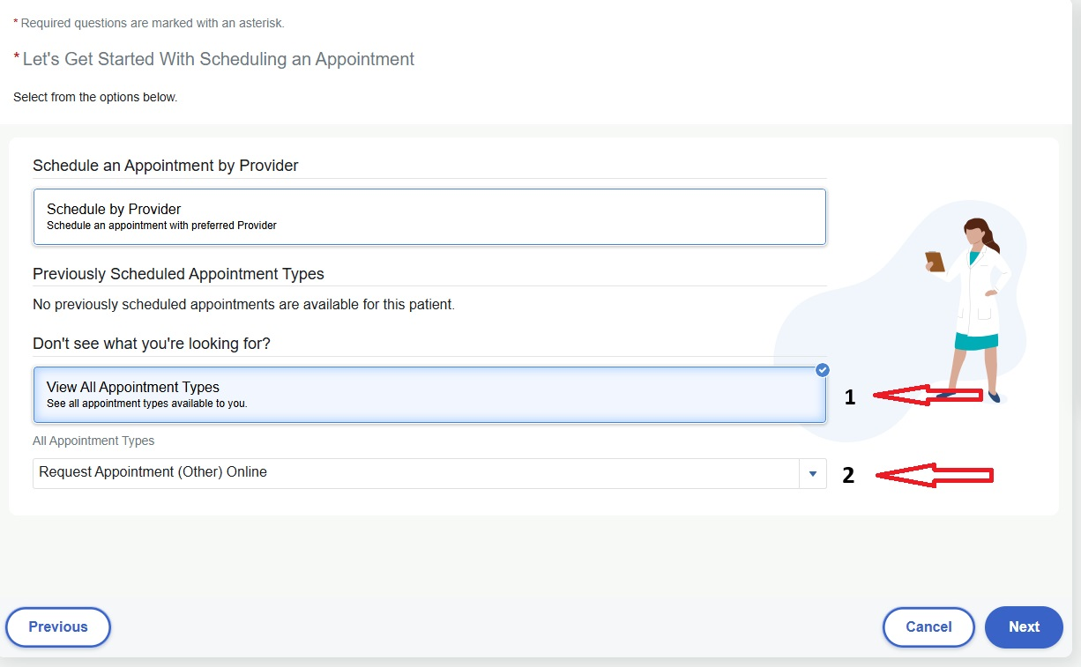
Step 7
Select “View All Appointment Types Tab”
Select “Appointment Type” drop down Tab
Select “Request Appointment (other) Online”
Select “Next”

Slide 9
Step 8
Fill out all tabs
In “Send Request to” drop down tab, type in “San Diego NTC Medical Readiness Center PHA Team”
In “Why is this appointment needed” tab, type “PHA; PDHA, etc”
Once all tabs completed, select “Send Request”
Source: FMIS as of 26AUG24

Slide 10
Step 9
Once you have confirmation of your sent request, give the PHA team 72 hours to respond to request.
You will be contacted via MHS Genesis Patient Portal message and phone to set up your PHA appointment.
Source: FMIS as of 26AUG24

